Slide 1
COMP6115 Object Oriented Analysis and Design Session #6

Slide 2
Behavioral Modeling

Slide 3
Learning Outcomes
LO1: Identify the basic concept of advance topic in
Object Oriented Analysis and Design
LO2 : Use the knowledge to develop documentation
for object oriented software analysis and
design using Unified Modelling Language
LO3 : Analyze any problem in any software
application and find out the alternative
solutions using object oriented analysis and
design approach

Slide 4
Chapter 6: Behavioral Modeling

Slide 5
Learning Objectives
Understand the rules and style guidelines for sequence and communication diagrams and behavioral state machines.
Understand the processes used to create sequence and communication diagrams, behavioral state machines and CRUDE matrices.
Be able to create sequence and communication diagrams, behavioral state machines and CRUDE matrices.
Understand the relationship between the behavioral models and the structural and functional models.

Slide 6
UML Diagram Types

Slide 7
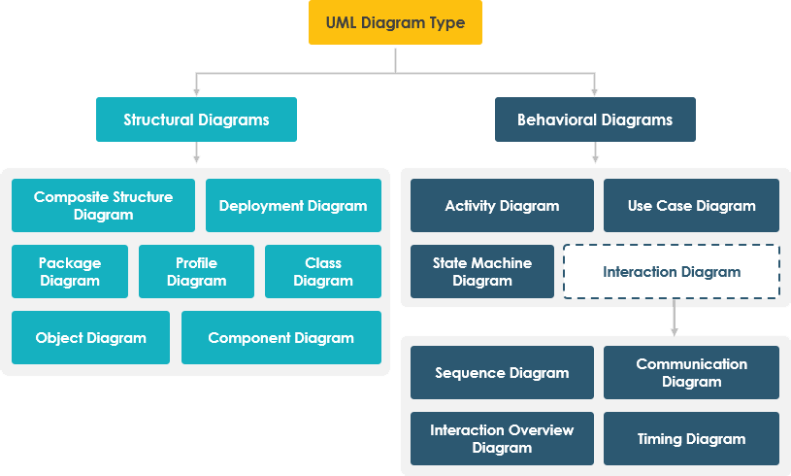
UML Diagram Types
Structural diagrams show the things in the modeled system. In a more technical term, they show different objects in a system.
Behavioral diagrams describe the internal behavior of a system. They describe how the objects interact with each other to create a functioning system.

Slide 8
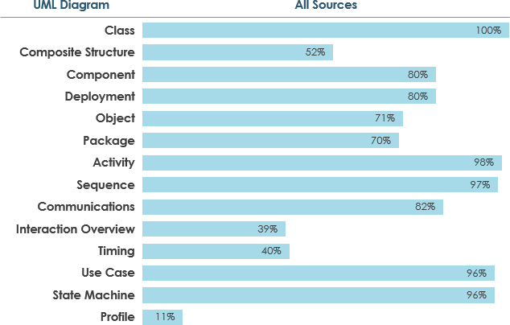
UML Diagram Types
We could interpret the results of the UML survey by assuming that, if a diagram is:
Widely used, if it ≥ 60% of the sources
Scarcely used if it is ≤ 40% of the sources

Slide 9
Behavioral Models

Slide 10
Introduction
Behavioral models describe the internal behavior of a system
Behavioral model types:
Representations of the details of a business process identified by use-cases
Interaction diagrams (Sequence & Communication)
Shows how objects collaborate to provide the functionality defined in the use cases.
Representations of changes in the data
Behavioral state machines
Focus (for now) is on the dynamic view of the system, not on how it is implemented

Slide 11
Behavioral Models
Analysts view the problem as a set of use cases supported by a set of collaborating objects
Aids in organizing and defining the software
Behavioral models depict this view of the business processes:
How the objects interact and form a collaboration to support the use cases
An internal view of the business process described by a use case
Creating behavioral models is an iterative process which may induce changes in other models

Slide 12
Interaction Diagrams

Slide 13
Interaction Diagrams
Objects: an instantiation of a class
Patient is a class
Mary Wilson is an instantiation of the patient class (object)
Attributes: characteristics of a class
Patient class: name, address, phone, etc.
Operations: the behaviors of a class, or an action that an object can perform
Messages: information sent to objects to tell them to execute one of their behaviors
A function call from one object to another
Types
Sequence Diagrams—emphasize message sequence
Communication Diagrams—emphasize message flow

Slide 14
Sequence Diagrams

Slide 15
Sequence Diagrams
Illustrate the objects that participate in a single use-case
A dynamic model
Shows the sequence of messages that pass between objects
Aid in understanding real-time specifications and complex use-cases
Generic diagram shows all scenarios for a use-case
Instance diagrams show a single scenario

Slide 16
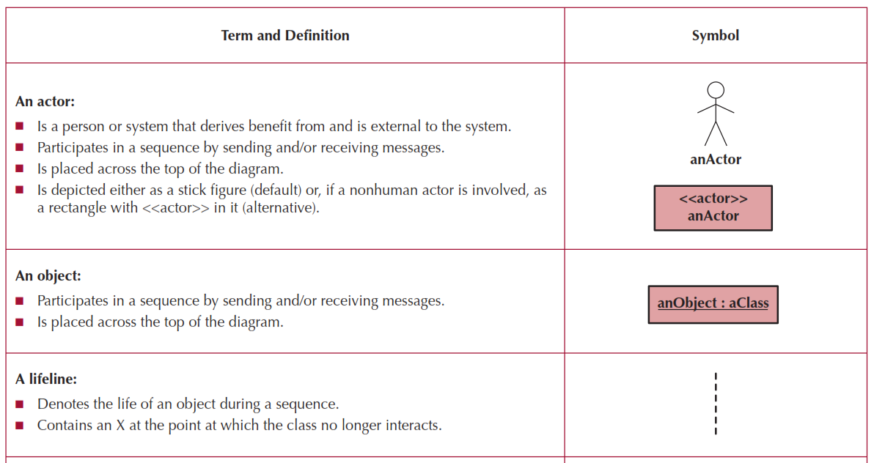
Sequence Diagram Syntax

Slide 17
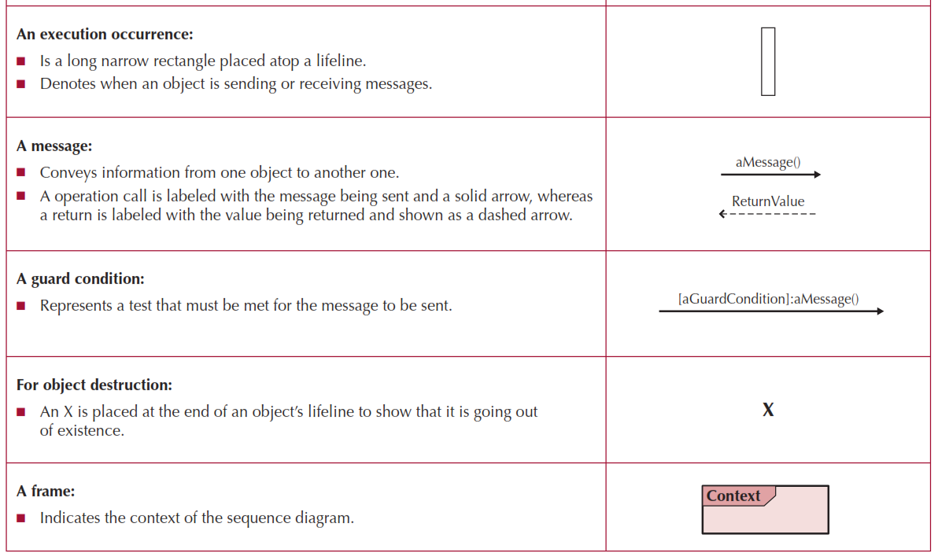
More Sequence Diagram Syntax

Slide 18
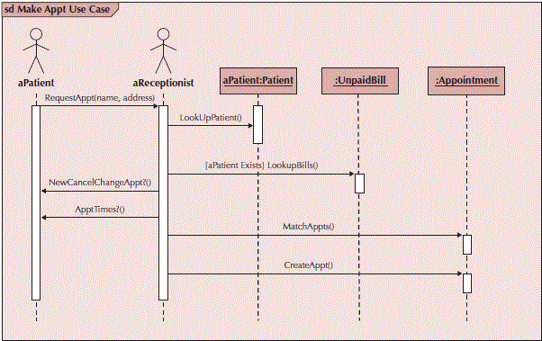
Sample Sequence Diagram

Slide 19
Building Sequence Diagrams
Set the context
Identify actors and objects that interact in the use-case scenario
Set the lifeline for each object
Add messages by drawing arrows
Shows how they are passed from one object to another
Include any parameters in parentheses
Obvious return values are excluded
Add execution occurrence to each object’s lifeline
Validate the sequence diagram
Ensures that it depicts all of the steps in the process

Slide 20
Communication Diagrams

Slide 21
Communication Diagrams
Depict the dependencies among the objects
An object diagram that shows message passing relationships
Emphasize the flow through a set of objects

Slide 22
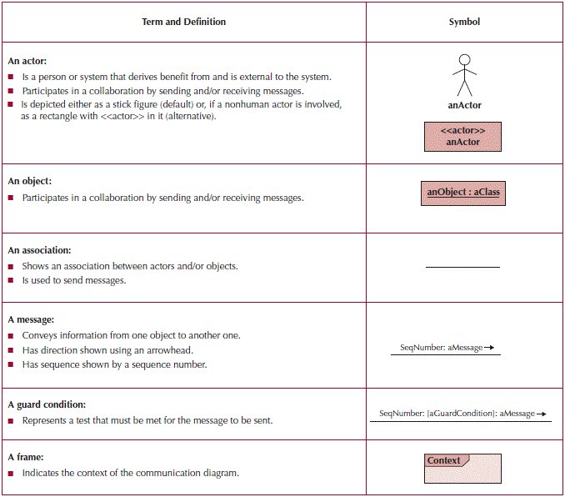
Communication Diagram Syntax

Slide 23
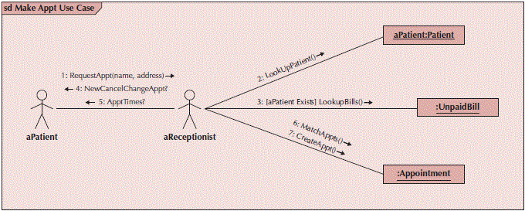
Sample Communication Diagram

Slide 24
Building Communication Diagrams
Set the context
Identify objects, actors and associations between them
Lay out the diagram
Add the messages
Validate the model

Slide 25
Sequence Diagrams VS Communication Diagrams

Slide 26
Sequence vs Communication
Communication Diagrams emphasize links between participants
Sequence Diagrams emphasize time ordering of messages

Slide 27
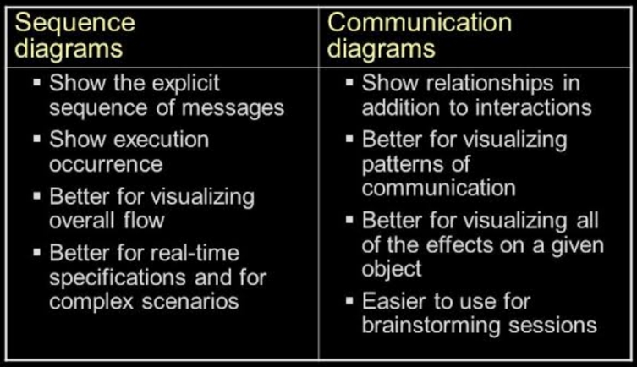
Sequence vs Communication
Both are used to examine the behavior of objects within a single use case.

Slide 28
Behavioral State Machines

Slide 29
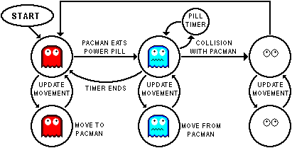
What is State?

Slide 30
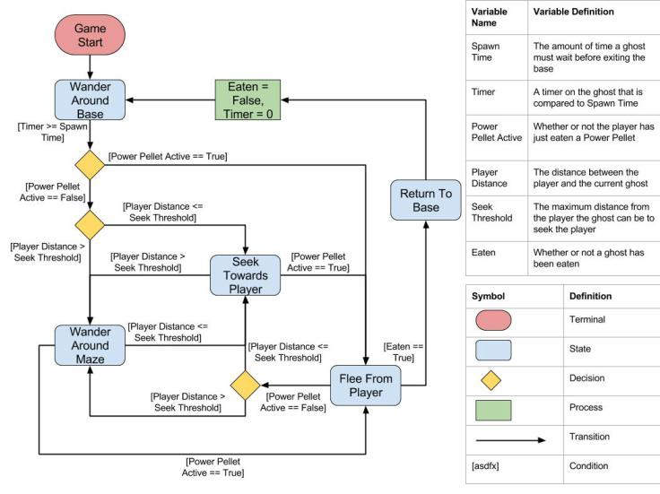
What is State?

Slide 31
Behavioral State Machines
Objects may change state in response to an event
Different states are captured in this model
Shows the different states through which a single object passes during its life
May include the object’s responses and actions
Example: patient states
New patient—has not yet been seen
Current patient—is now receiving treatment
Former patient—no longer being seen or treated
Typically used only for complex objects

Slide 32
Components of State Machines
States—values of an object’s attributes at a point in time
Events—the cause of the change in values of the object’s attributes
Transitions—movement of an object from one state to another
May include a guard condition to flag that a condition is true and allow the transition

Slide 33
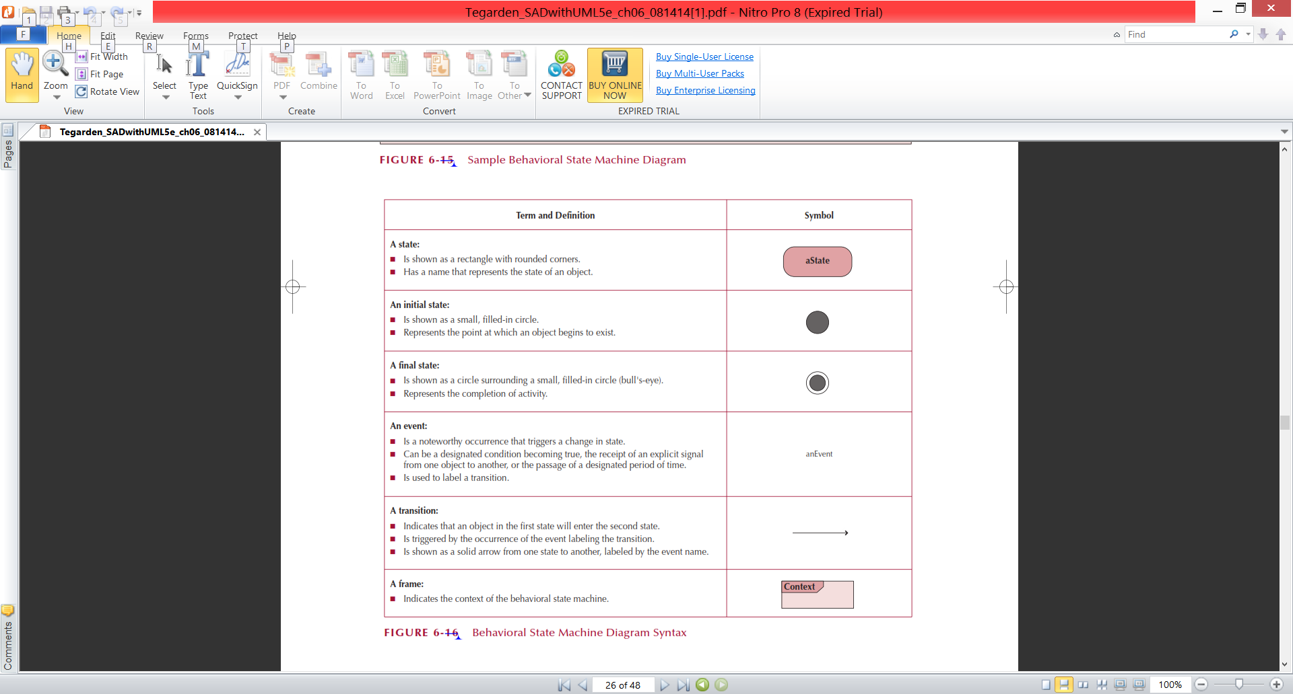
State Machine Syntax

Slide 34
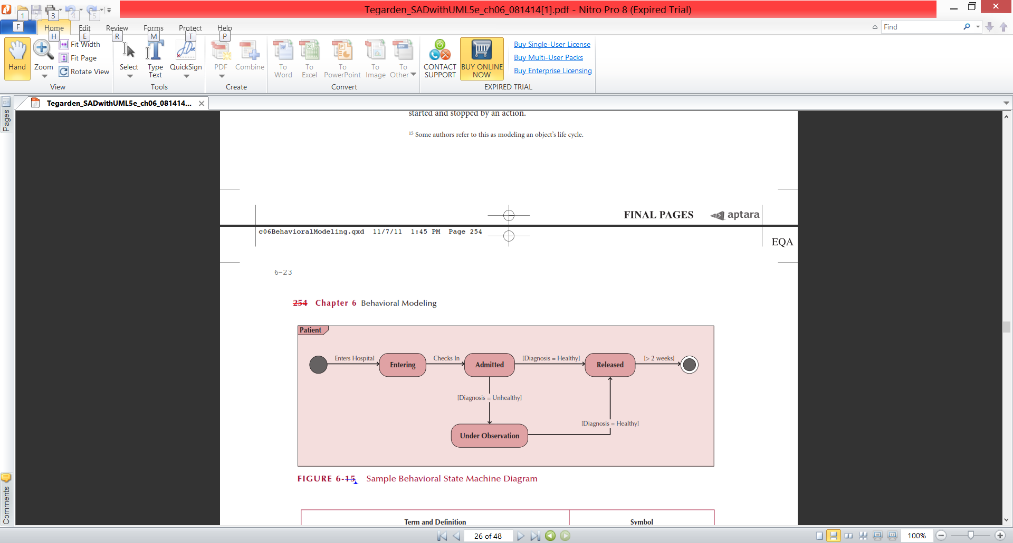
Sample State Machine

Slide 35
Guidelines for Creating Behavioral State Machines
Use only for complex objects
Draw the initial state in the upper left corner
Draw the final state in the bottom right corner
Use simple, but descriptive names for states
Look out for “black holes” and “miracles”
Ensure guard conditions are mutually exclusive
Ensure transitions are associated with messages and operations

Slide 36
Building a Behavioral State Machine
Set the context
Identify the states of the object
Initial
Final
Stable states during its lifetime
Lay out the diagram—use a left to right sequence
Add the transitions
Identify the triggers (events that cause the transition)
Identify the actions which execute
Identify the guard conditions
Validate the model—ensure all states are reachable

Slide 37
CRUDE Analysis

Slide 38
CRUDE Analysis
Helps to identify object collaborations
Labels object interaction in 5 possible ways:
Create—can one object create another?
Read—can one object read the attributes of another?
Update—can one object change values in another?
Delete—can one object delete another object?
Execute—can one object execute the operations of another?
Utilizes a matrix to represent objects and their interactions
Most useful as a system-wide representation

Slide 39
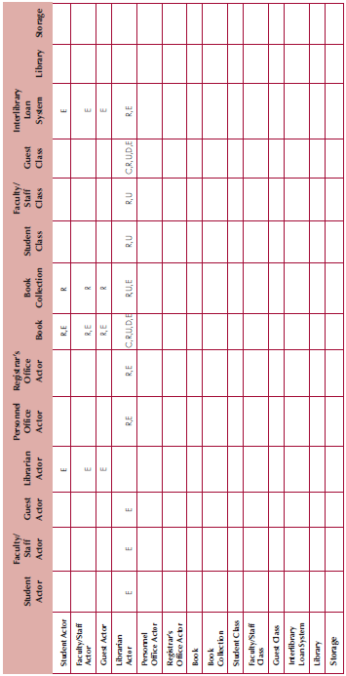
Sample CRUDE Matrix

Slide 40
Verifying & Validating Behavioral Models
Actors must be consistent between models
Messages on sequence diagrams must match associations on communication diagrams
Every message on a sequence diagram must appear on an association in a communication diagram
Guard conditions on a sequence diagram must appear on a communication diagram
Sequence of messages must correspond to the top down ordering of messages being sent
State transitions must be associated with a message on a sequence diagram
Entries in a CRUDE matrix imply messages being sent

Slide 41
Summary

Slide 42
Summary
Behavioral Models—provide a detailed view of how object collaborations support use-cases
Interaction Diagrams
Sequence diagrams
Communication diagrams
Behavioral State Machines—depicts the states of complex objects during its lifetime
CRUDE Analysis—helps to identify potential collaborations
Verifying & Validating behavioral models—ensures the completeness and consistency of the models

Slide 43
UML Diagram Types
Structural diagrams show the things in the modeled system. In a more technical term, they show different objects in a system.
Behavioral diagrams describe the internal behavior of a system. They describe how the objects interact with each other to create a functioning system.

Slide 44
References
Denis, Wixom,Tegarden. (2015). Systems Analysis and Design: An Object-Oriented Approach with UML. 5th edition. ISBN: 978-1-118-80467-4, John Wiley & Sons, Inc, Denver (USA)

